Slide 1
Software Measurements and Metrics

Slide 2
Software Measurements
Software Measurement is an indicator of size, quantity, amount, or dimension of a particular attribute of a product or process.
It helps the project manager and the entire software team to take decisions that lead to successful completion of the project by generating quantity results.
Software measurements are of two categories:
Direct Measures: These include software processes like Cost & Effort applied, Lines of Code (LOC) produced, Execution speed, and the Total number of errors reported.
Indirect Measures: These include products like Functionality, Quality, Complexity, Reliability, Maintainability, and others.
1

Slide 3
Software Metrics
Software Metrics provide measures, functions, or formulas for various aspects of the software process and product.
Uses include measuring software performance, planning work items, and measuring productivity.
Software metrics are categorized into three types:
Product Metrics: Estimate the size, complexity, quality, and reliability of the software.
Process Metrics: Estimate the fault rate during development, patterns of testing defect arrival, and the time taken for fixed operations.
Project Metrics: Estimate the number of software developers, cost, scheduling, and productivity of the software.
1

Slide 4
Software Measurements Principle
The process involves five key steps:
Formulation: Deriving measures and metrics appropriate for the software representation.
Collection: The mechanism used to accumulate data required for the metrics.
Analysis: The computation of metrics and application of mathematical tools.
Interpretation: Evaluating metrics to gain insight into the quality of the representation.
Feedback: Recommendations derived from interpretation transmitted to the software team.
1

Slide 5
Size Metrics: LOC (Lines of Code)
Size-Oriented Metrics focus on the size of the program created.
LOC is one of the earliest and simplest metrics for calculating program size.
It is used to calculate and compare programmer productivity.
LOC does not count comments or blank lines.
Example:
Total Line of Code (LOC) = 09
a = 10
b = 20
sum = a + b
print(sum)
if sum > 20:
print("Large")
else:
print("Small")
print("Done")
1

Slide 6
Size Metrics: LOC (Lines of Code)
Advantages:
Widely used in cost estimation.
Very easy for estimating efforts.
Disadvantages:
Cannot measure the size of the specification.
Bad software design can lead to an excessive number of lines.
It is language dependent.
Users cannot easily understand it.
1

Slide 7
Size Metrics: LOC (Lines of Code)
Project | LOC | Cost $K | Efforts (Persons/ Month) | Documentation | Errors
A | 10000 | 110 | 18 | 365 | 39
B | 12000 | 115 | 20 | 370 | 45
C | 15400 | 130 | 25 | 400 | 32
1

Slide 8
Size Metrics: FP (Function Point)
Function-oriented metrics measure the functionality the system performs, serving as a measure of system size.
It is determined by counting the number and types of functions used in the application.
Measurements Parameters | Examples
1. Number of External Inputs (EI) | Input screen and tables
2. Number of External Output (EO) | Output screens and reports
3. Number of external inquiries (EQ) | Prompts and interrupts.
4. Number of internal files (ILF) | Databases and directories
5. Number of external interfaces (EIF) | Shared databases and shared routines.
1

Slide 9
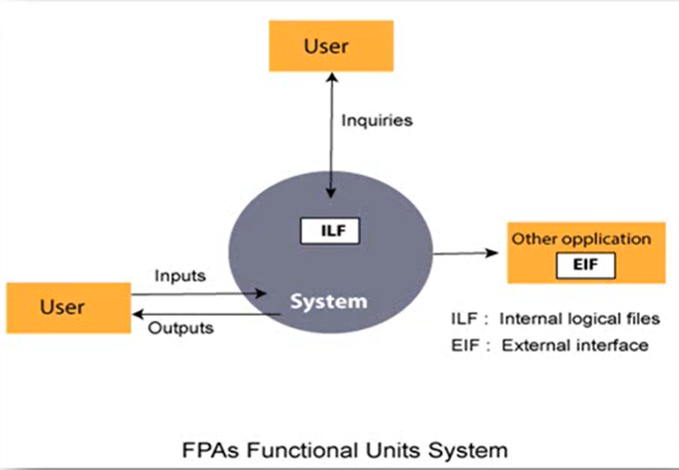
Size Metrics: FP (Function Point)
1

Slide 10
Size Metrics: FP (Function Point)
Advantages:
Does not restricted to code and is language independent.
Disadvantages:
Ignores quality issues.
Counting is subjective and depends on estimation.

Slide 11
Size Metrics: FP (Function Point)
Info Domain | Optimistic | Likely | Pessim. | Est Count | Weight | FP count
# of inputs | 22 | 26 | 30 | 26 | 4 | 104
# of outputs | 16 | 18 | 20 | 18 | 5 | 90
# of inquiries | 16 | 21 | 26 | 21 | 4 | 84
# of files | 4 | 5 | 6 | 5 | 10 | 50
# of external interf | 1 | 2 | 3 | 2 | 7 | 14
UFC: Unadjusted Function Count |  |  |  |  |  | 342
 |  |  | Complexity adjustment factor |  |  | 1.17
 |  |  |  |  | FP | 400

Slide 12
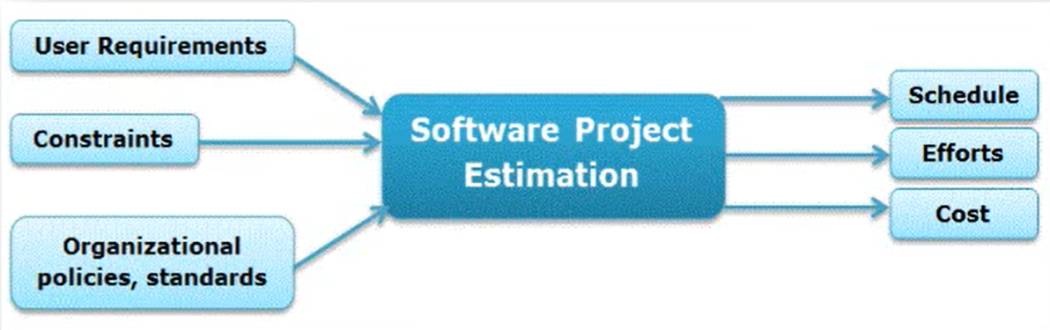
Software Project Estimation
1

Slide 13
Software Project Estimation
Effective software project estimation is important activity in software development project.
Estimation in software engineering is a procedure that predicts the time and budget that required for completing a project.
Project Estimation requires the use of complex tools & good mathematical as well as knowledge about planning.
One of the main reasons software programs fail is our inability to accurately estimate software size.
➤ Responsible Persons:
❑ Software Manager
❑ Cognizant Engineers
❑ Software Estimators.
1

Slide 14
Software Project Estimation
Key Estimation Factors:
Cost: Ensuring sufficient funds are available at an early stage.
Time: Estimating overall duration and individual task timing.
Size & Scope: Identifying all tasks needed to deliver the product.
Risk: Predicting and planning for serious events during the life cycle.
Resources: Managing people, hardware, software, and materials.
1

Slide 15
Steps of Software Project Estimation:
Estimate Project Size
Estimate Efforts (Person per month / hr)
Estimate Project Schedule (Month / Year)
Estimate Project Cost (Currency / Dollars)
1

Slide 16
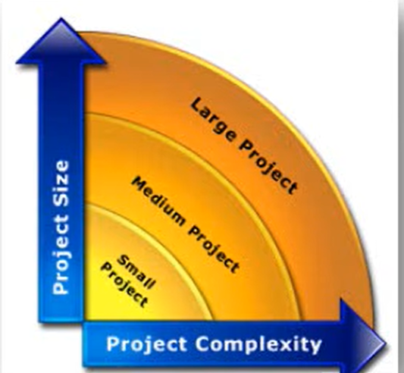
Steps of Software Project Estimation:
1. Estimate Product Size (LOC & FP):
It is the very first step to make an effective estimation of the project.
A Customer's requirements, SRS Document & System design document used for estimating the size of a software.
Estimate project size can be through similar project developed in past. This is called estimation by Analogy.
The system is divided into several subsystems depending on functionality & size of each subsystem is calculated.
1

Slide 17
Steps of Software Project Estimation:
2. Estimate Project Efforts:
The estimation of effort can be made from the organizational specifics of SDLC.
Software development project involves Design, Coding, Testing, Writing, Reviewing documents, Implementing prototypes & Deliverable it decide overall project efforts.
The project effort estimate requires you to identify and estimate & then sum up all the activities you must perform to build a product of the estimated size.
1

Slide 18
Steps of Software Project Estimation:
There are two main ways:
The best way to estimate effort is based on the organization's own historical data of development process. Suppose you have similar SDLC, Project size, Development methodology, Tools, Team with similar skills and experience for the new project.
If the project is in different nature which requires the organization to adopt different strategy or different models based on algorithmic approach. Ex. COCOMO Model.
1

Slide 19
Steps of Software Project Estimation:
3. Estimate Project Schedule:
It involves estimating number of people who will work on the project & what they will work on (the Work Breakdown Structure).
Also when they will start working on project & when they will finish.
Once you have this information, you need to lay it out into a calendar schedule.
Efforts in man-month are translated to calendar months thumb rule is used.
The parameter 3.0 is variable, used depending on the situation which works best for the organization.
1

Slide 20
Steps of Software Project Estimation:
4. Estimate Project Cost:
The cost of a project is derived not only from the estimates of person efforts and size.
Other parameters such as purchase hardware, software, travel for meeting, telecommunication costs (long distance phone calls, video-conferences), training, office space etc.
Exactly how you estimate total project cost will depend on how your organization allocates costs.
The simplest labor cost can be obtained by multiplying the project's effort estimate (in hours) by a general labor rate ($ per hour).
A more accurate labor cost would result from using a specific labor rate for each staff position (e.g., Technical, QA, Project Management, Documentation, Support, etc.)
1

Slide 21
Decomposition Techniques
Software Project Estimation is a form of problem solving (To estimate cost, time & efforts in software project.)
Decomposition Technique is divide & conquer approach of Software Project Estimation.
By decomposition a project into major functions like software engineering related activities, cost, schedule & efforts estimation can be performed in stepwise manner.
➢Decomposition Techniques are:
Software Sizing
Problem based Estimation
Process based Estimation
1

Slide 22
1. Software Sizing
Sizing represents the project planner's first major challenge.
➢The accuracy of a software project estimate is predicated on a number of things:
The degree to which the planner has properly estimated the size of the product to be built.
The ability to translate the size estimate into human effort, calendar time and dollars.
The degree to which the project plan reflects the abilities of the software team.
The stability of product requirements & environment that supports software engineering effort.
1

Slide 23
1. Software Sizing
Approaches of Software Sizing:
“Fuzzy Logic” Sizing
Function Point Sizing
Standard Component Sizing
Change Sizing
1

Slide 24
1. Software Sizing
Approaches of Software Sizing
Putnam and Myers suggest four different approaches of Software Sizing Problem:
1. “Fuzzy Logic” Sizing:
To apply this approach, the planner must identify the type of application.
Although personal experience can be used, the planner should also have access to historical database of projects so that estimates can be compared to actual experience.
2. Function Point Sizing:
The planner develops estimates of the information domain characteristics.
1

Slide 25
1. Software Sizing
3. Standard Component Sizing:
Standard components for an information system are subsystems, modules, screens, reports, interactive programs, batch programs, files, LOC and object-level instructions.
Uses historical project data to determine the delivered size per standard component.
4. Change Sizing:
This approach is used when a project encompasses the use of existing software that must be modified in some way as part of a project.
The planner estimates reuse, adding code, changing code, deleting code of modifications that must be accomplished.
Using an “effort ratio” for each type of change, the size of the change may be estimated.
1

Slide 26
2. Problem based Estimation
Lines of code and function points were described as measures from which productivity metrics can be computed. (LOC/pm & FP/pm)
LOC and FP data are used in two ways during software project estimation:
As an estimation variable to "size" each element of the software.
As baseline metrics collected from past projects and used in conjunction with estimation variables to develop cost and effort projections.
A three-point or expected value can be computed using the following formula:
S = (sₒₚₜ + 4sₘ + sₚₑₛₛ) / 6
Where:
S = expected value for the estimation variable (size)
sₒₚₜ = optimistic value
sₘ = most likely value
sₚₑₛₛ = pessimistic value.
1

Slide 27
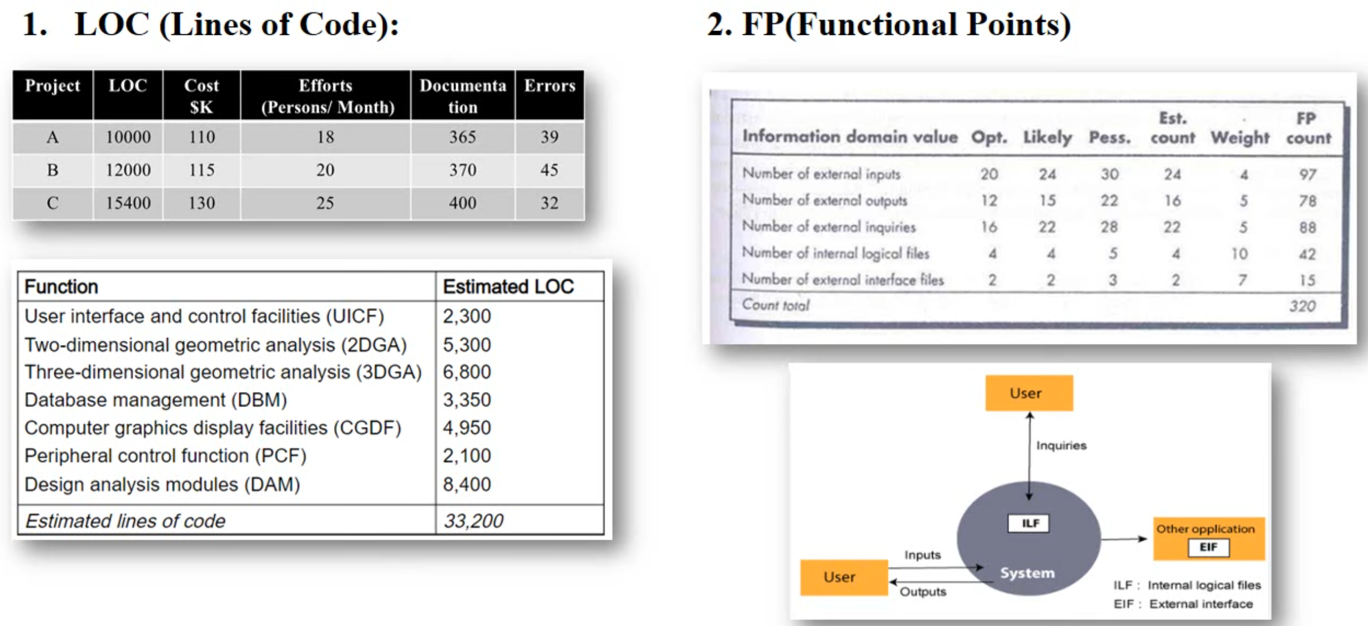
Examples of LOC
1

Slide 28
3. Process based Estimation
Most common technique for estimating project is to estimate on the process that will be used.
The process is decomposed into a relatively small set of tasks and the effort required to accomplish each task is estimated.
Once problem functions & process activities are decided, the planner estimates the effort (e.g., person-months) that will be required to accomplish each software process activity for each software function.
Average labor rates (cost/unit effort) are then applied to the effort estimated for each process activity.
It is very likely the labor rate will vary for each task.
Senior staff heavily involved in early activities are generally more expensive than junior
1

